Slide 1
A guide to creating OERs
Library and Information Services
2020
T: +27 51 401 3680 | www.ufs.ac.za/library | E: email@ufs.ac.za

Slide 2
This work is licensed under a Creative Commons Attribution-ShareAlike 4.0 International License.

Slide 3
What is an OER?
Open Educational Resources (OERs) are free, publicly available, online educational resources* that anyone can copy, use, adapt and re-share.
*Any educational resource, including curriculum maps, course materials, textbooks, streaming videos, multimedia applications, podcasts, and any other materials that have been designed for use in teaching and learning.

Slide 4
"OER has emerged as a concept with great potential to support educational transformation. While its educational value lies in the idea of using resources as an integral method of communication of curriculum in educational courses (i.e. resource-based learning), its transformative power lies in the ease with which such resources, when digitized, can be shared via the Internet. Importantly, there is only one key differentiator between an OER and any other educational resource: its licence. Thus, an OER is simply an educational resource that incorporates a licence that facilitates reuse, and potentially adaptation, without first requesting permission from the copyright holder."

Slide 5
Considerations for using OERs

Slide 6
How will OER improve my course?
What do I want my students to learn?
How will I communicate to students that the concepts I present are valuable?
How will I assess my students' understanding of core concepts?

Slide 7
Who is my audience?
Who is my primary audience?
Create your OER with your local audience in mind – OERs can be adapted for local context.

Slide 8
Does the OER I need already exist?
What changes would you need to create your own OER?
What types and formats of OER are you looking for?
Where should you begin to search?

Slide 9
How will I disseminate my OER?
Where will it be hosted?
How will you make sure updates to your content is communicated?
How will students access the OER?

Slide 10
What expertise is needed to use and create OERs?
What aspects of using/creating OERs are you most and least comfortable with?
What support is available at the University to help you structure, develop and disseminate your OER?
Is there support available to make your OER accessible in multiple formats?

Slide 11
Can my OER be easily reused and repurposed?
What formats are you going to use?
Is your OER designed in such a way that a user can pick and choose which content to use?

Slide 12
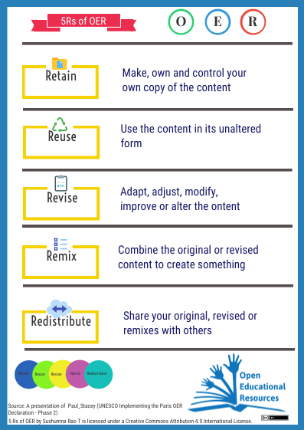
The 5 R’s of OER

Slide 13
Copyright and open licensing

Slide 14
What is copyright and CC?
Copyright refers to laws that govern the use of the creative works of an author or creator. The works of writers, artists and musicians are usually governed by copyright, whether this is explicitly stated or not, and is automatic. Under copyright, exclusive rights (access, use, print, copy, display, distribute, perform, modify or sell) belong to the author or creator.
A copyright holder can grant permission, or license, to allow others to use, print, copy, display, distribute, perform, modify or sell their work. Open licenses were created to make it easier for a creator to share their work freely with the public. Creative Commons licenses are mostly used.
Featured Photo: Kristina Alexanderson, via Flickr || CC BY-SA 2.0

Slide 15
Creative Commons
License | Retain? | Reuse? | Revise? | Remix? | Redistrbute?
CC-Zero | Yes | Yes | Yes | Yes | Yes
Attribution | Yes | Yes | Yes | Yes | Yes
Attribution ShareAlike | Yes | Yes | Yes | Yes | Yes, but
Attribution Noncommercial | Yes | Yes, but | Yes | Yes | Yes, but
Attribution Noncommercial ShareAlike | Yes | Yes, but | Yes | Yes | Yes, but
Attribution No Derivatives | Yes | Yes | No | No | Yes
Attribution Noncommercial No Derivatives | Yes | Yes, but | No | No | Yes, but
All Rights Reserved | No | No | No | No | No

Slide 16
CC FAQs
Where do I find the license for an OER?
How do I provide attribution?
How does ShareAlike work?
Are there any licenses to avoid?
What about the Noncommercial component?

Slide 17
How to find OERs

Slide 18
Assessing OER quality
“Because the better the OER quality the better the education.”
WikiEducator – free learning content (https://wikieducator.org/WikiEducator:Quality_Assurance_Framework/)

Slide 19
Review criteria
Comprehensiveness
Content accuracy
Relevance/longevity
Clarity
Consistency
Modularity
Organisation/structure/flow
Interface
Grammatical errors
Cultural relevance

Slide 20
Creating OERs

Slide 21
Planning and completing your OER project
Think about the devices you and your students use.
What is your delivery platform?
Test your content on the devices/platform.
Look at other OERs for ideas and inspiration.
Understand copyright and open licensing.
Create diverse content, using different formats.
Always evolve with new ideas, approaches and technology.

Slide 22
Tools and techniques to create OERs
Start with what you already have.
Make sure your OER is accessible to all.
Your content should be adaptable for reuse.
Make your content open using CC licenses.
Make your content discoverable.
Evaluate your OERs rigorously.

Slide 23
More guides

Slide 24
Self-learning courses and guidelines
OER Toolkit
Reynolds OER guide
Open Education Handbook
YouTube open educational resources
OpenEd Group resources
Introduction to Open Educational Resources
Algon Quin College OER guide
PSU OER guide
WITS OER guide
FHSU OER guide

Slide 25
https://ufs.libguides.com/oer
https://ufs.figshare.com/ufsoer

